Slide 1
Training
Shimul Majumdar
Student ID:20191119010
Section:D

Slide 2
What do you mean by Training?
Training is teaching, or developing in oneself or others, any skills and knowledge or fitness that relate to specific useful competencies. Training has specific goals of improving one's capability, capacity, productivity and performance. It forms the core of apprenticeships and provides the backbone of content at institutes of technology (also known as technical colleges or polytechnics). In addition to the basic training required for a trade, occupation or profession, training may continue beyond initial competence to maintain, upgrade and update skills throughout working life. People within some professions and occupations may refer to this sort of training as professional development. Training also refers to the development of physical fitness related to a specific competence, such as sport, martial arts, military applications and some other occupations

Slide 3
Types of Training?
1.1Physical training.
1.2Occupational skills training.
1.3On job training.
1.4Religion and spirituality.
1.4.1Church-affiliated schools.
1.5Instructor's guides and Lesson Plans.
1.6Artificial-intelligence feedback.

Slide 4
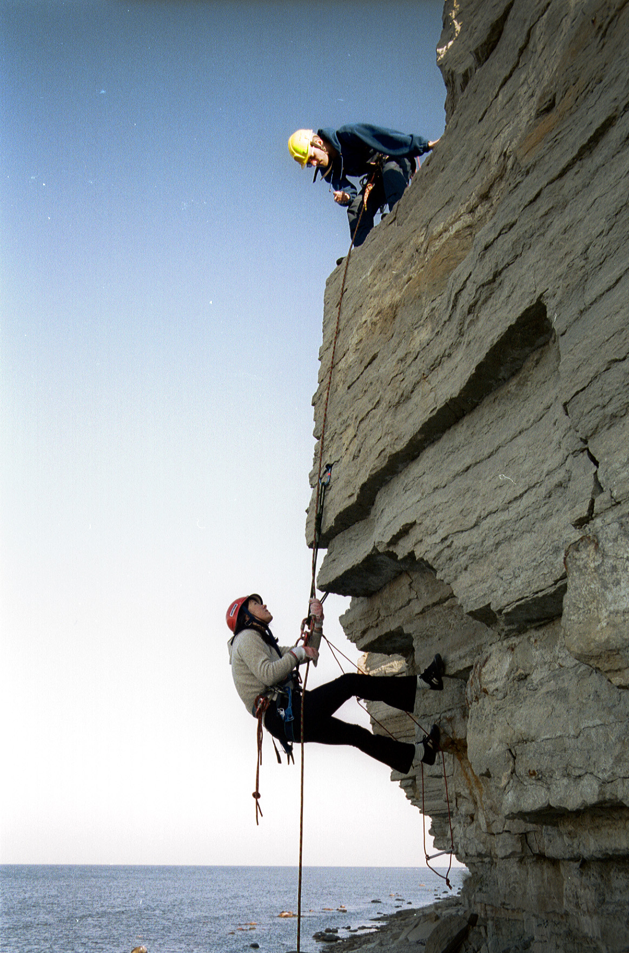
Physical training
Physical training concentrates on mechanistic goals: training programs in this area develop specific motor skills, agility, strength or physical fitness, often with an intention of peaking at a particular time.
In military use, training means gaining the physical ability to perform and survive in combat, and learn the many skills needed in a time of war. These include how to use a variety of weapons, outdoor survival skills, and how to survive being captured by the enemy, among many others. See military education and training.
For psychological or physiological reasons, people who believe it may be beneficial to them can choose to practice relaxation training, or autogenic training, in an attempt to increase their ability to relax or deal with stress.^{[1]} While some studies have indicated relaxation training is useful for some medical conditions, autogenic training has limited results or has been the result of few studies.

Slide 5
Occupational skills training
Some occupations are inherently hazardous, and require a minimum level of competence before the practitioners can perform the work at an acceptable level of safety to themselves or others in the vicinity. Occupational diving, rescue, firefighting and operation of certain types of machinery and vehicles may require assessment and certification of a minimum acceptable competence before the person is allowed to practice as a licensed instructor.

Slide 6
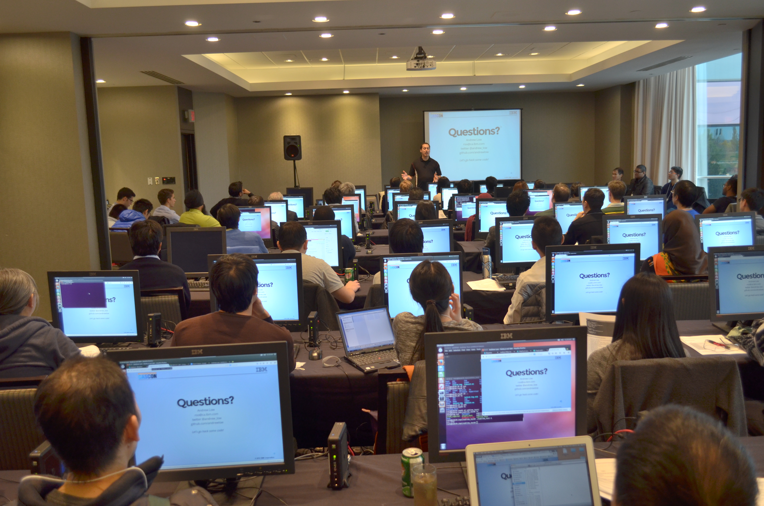
On job training
Some commentators use a similar term for workplace learning to improve performance: "training and development". There are also additional services available online for those who wish to receive training above and beyond that which is offered by their employers. Some examples of these services include career counseling, skill assessment, and supportive services.^{[2]} One can generally categorize such training as on-the-job or off-the-job.
The on-the-job training method takes place in a normal working situation, using the actual tools, equipment, documents or materials that trainees will use when fully trained. On-the-job training has a general reputation as most effective for vocational work.^{[3]} It involves employees training at the place of work while they are doing the actual job. Usually, a professional trainer (or sometimes an experienced and skilled employee) serves as the instructor using hands-on practical experience which may be supported by formal classroom presentations. Sometimes training can occur by using web-based technology or video conferencing tools.
Simulation based training is another method which uses technology to assist in trainee development. This is particularly common in the training of skills requiring a very high degree of practice, and in those which include a significant responsibility for life and property. An advantage is that simulation training allows the trainer to find, study, and remedy skill deficiencies in their trainees in a controlled, virtual environment. This also allows the trainees an opportunity to experience and study events that would otherwise be rare on the job, e.g., in-flight emergencies, system failure, etc., wherein the trainer can run 'scenarios' and study how the trainee reacts, thus assisting in improving his/her skills if the event was to occur in the real world. Examples of skills that commonly include simulator training during stages of development include piloting aircraft, spacecraft, locomotives, and ships, operating air traffic control airspace/sectors, power plant operations training, advanced military/defense system training, and advanced emergency response training.

Slide 7
Religion and spirituality
In religious and spiritual use, the word "training" may refer to the purification of the mind, heart, understanding and actions to obtain a variety of spiritual goals such as (for example) closeness to God or freedom from suffering.^{[citation needed]} Note for example the institutionalised spiritual training of Threefold Training in Buddhism, meditation in Hinduism or discipleship in Christianity.^{[citation needed]} These aspects of training can be short-term or can last a lifetime, depending on the context of the training and which religious group it is a part of.^{[citation needed]}
Compare religious ritual.

Slide 8
Church-affiliated schools
Parochial schools are a fairly widespread institution in the United States. A parochial school is a primary or secondary school supervised by a religious organization, typically a Roman Catholic day-school affiliated with a parish or a holy order. As of 2004, out of the approximately 50 million children who were enrolled in American grade schools, 4.2 million children (approximately 1 in 12 students) attended a church-affiliated school.^{[5]}
Within the Christian religion one can attend a church-affiliated college with the intent of getting a degree in a field associated with religious studies. Some people may also attend church-affiliated colleges in pursuit of a non-religious degree, and typically do it just to deepen their understanding of the specific religion that the school is associated with.^{[citation needed]} The largest non-public school system in the United States, the Catholic school system, operates 5,744 elementary schools and 1,206 secondary schools.

Slide 9
Instructor's guides and Lesson Plans
Instructor Guide (IG), is an important document available to an instructor. Specifically, it is used within a Lesson Plan, as the blueprint that ensures instruction is presented in proper sequence and to the depth required by the objectives. Objectives of a lesson plan:
To ensure that instructors have considered all factors necessary to conduct a safe and effective lesson.
To guide you in conducting lesson activities.
To help maintain a constant check on training activities and students’ progress.
To Standardize instruction.
To inform training managers of what is being taught.^{[6]}

Slide 10
Artificial-intelligence feedback
Researchers have developed training methods for artificial-intelligence devices as well. Evolutionary algorithms, including genetic programming and other methods of machine learning, use a system of feedback based on "fitness functions" to allow computer programs to determine how well an entity performs a task. The methods construct a series of programs, known as a “population” of programs, and then automatically test them for "fitness", observing how well they perform the intended task. The system automatically generates new programs based on members of the population that perform the best. These new members replace programs that perform the worst. The procedure repeats until the achievement of optimum performance.^{[7]} In robotics, such a system can continue to run in real-time after initial training, allowing robots to adapt to new situations and to changes in themselves, for example, due to wear or damage. Researchers have also developed robots that can appear to mimic simple human behavior as a starting point for training.^{[8]}

Slide 11
References
1.www.google.com
2.www.edu.com
3.www.youtube.com

Slide 12
THANKS!
FELL FREE TO ASK ANY QUESTION

Slide 13
THE END

